Slide 1

HR Employee Attrition
BY:
ISHAN SINHA
JASLEEN HORA
NATASHA ARORA
RAVI GURRAM

Slide 2

BUSINESS CASE
A big company wants to understand why some of their best and most experienced employees are leaving prematurely. The company also wishes to predict which valuable employees will leave next.
"You don't build a business. You build people, and people build the business." - Zig Ziglar

Slide 3
PROBLEM STATEMENT
The company wants to understand what factors contributed most to employee turnover and to create a model that can predict if a certain employee will leave the company or not.
The goal is to create or improve different retention strategies on targeted employees.
Overall, the implementation of this model will allow management to create better decision-making actions.

Slide 4
SEMMA Approach to Data Mining
Sample
Selecting the data set for modeling
Explore
Discovering various relationships between the variables
Modify
Select, create and transform variables for data modeling
Model
Applying various modeling
Assess
Evaluation of the modeling

Slide 5










Identifying the Indicators that will help predict if an employee will leave the company or not
Satisfaction Level
Last Evaluation
Number of Projects
Average Monthly Hours
Time Spend Company
Work Accident
Promotion Last in 5 years
Department
Salary
Target Variable - Left
Whether the employee has left ?
The dataset was obtained from the Kaggle sample dataset repository that is commonly used for building models.

Slide 6
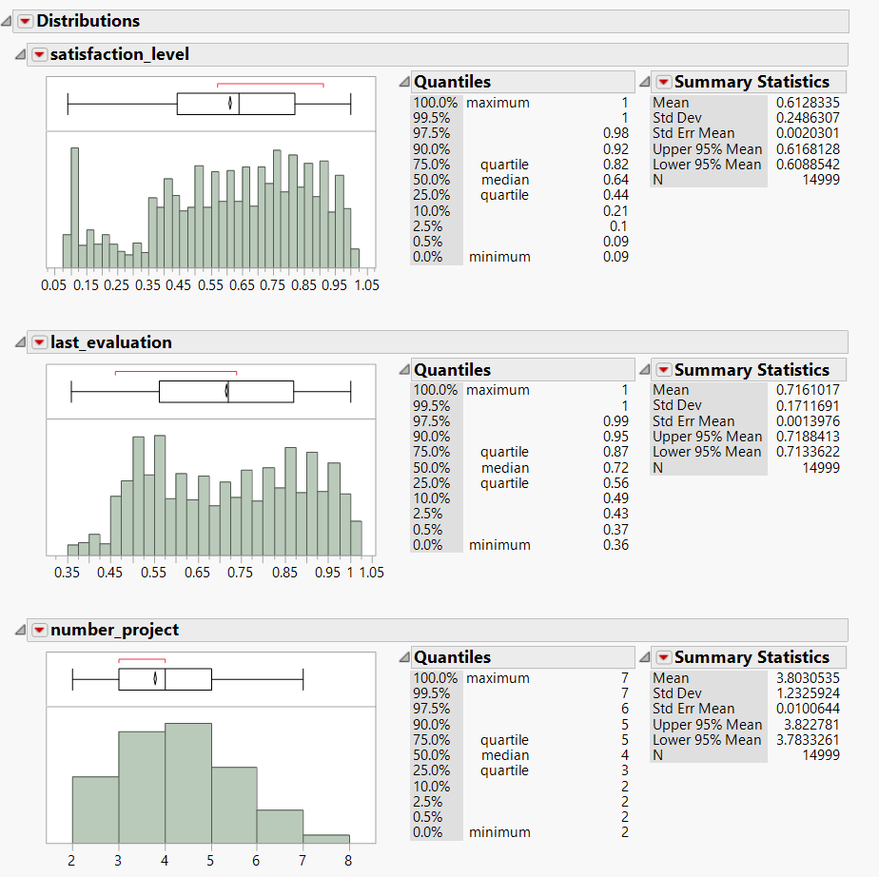
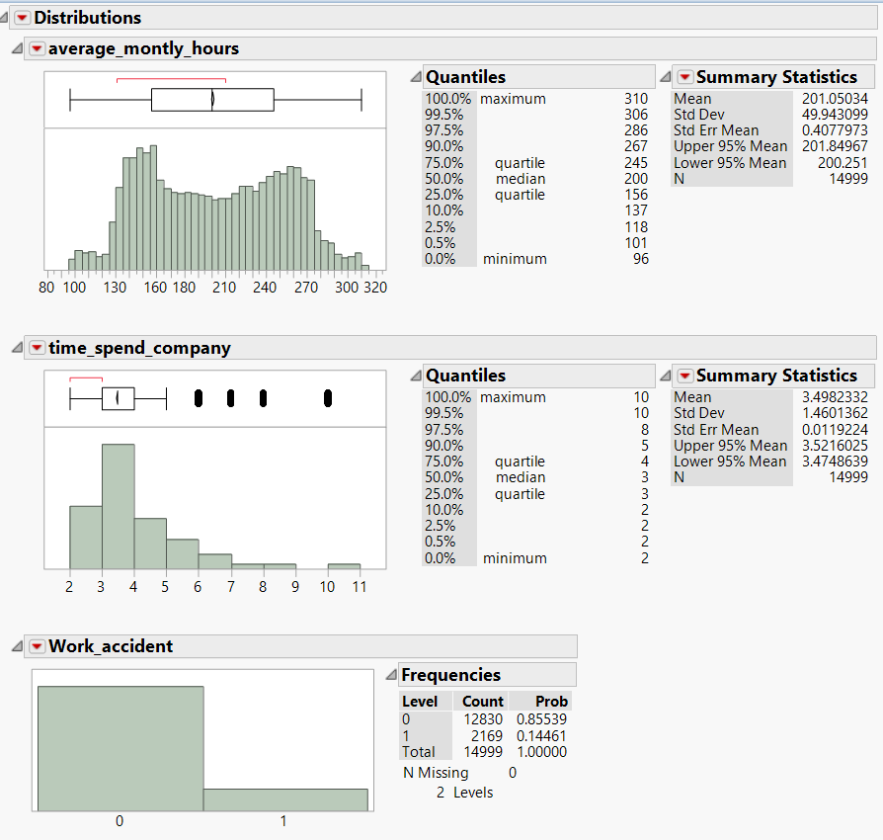
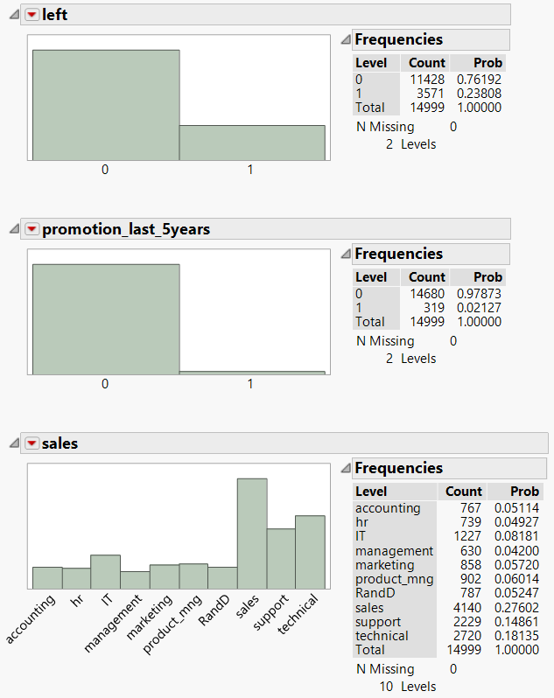
Exploratory data analysis was conducted to come up with high level insights about the business
Bimodal distribution of employees with lower and higher average monthly hours (less than 150 hours & more than 250 hours)
Bimodal distribution of employees for low evaluations (less than 0.6) and high evaluations (more than 0.8)

Slide 7

Exploratory Data Analysis was Conducted to Come up with High Level Insights about the Business
Average satisfaction level is 0.61
Only 8% of employees have high salary
Sales department has the highest no. of employees
Only 2% of employees got promoted in last 5 years
Standard deviation of the average monthly hours is 49.94 hours.
23% employees left the company
50% of the employees had their last evaluation done in 0.5 – 0.8 years back
Median number of projects is 4
Only 25% of the employees stay more than 4 years in the company
Only 14 % of the employees had accident during work

Slide 8
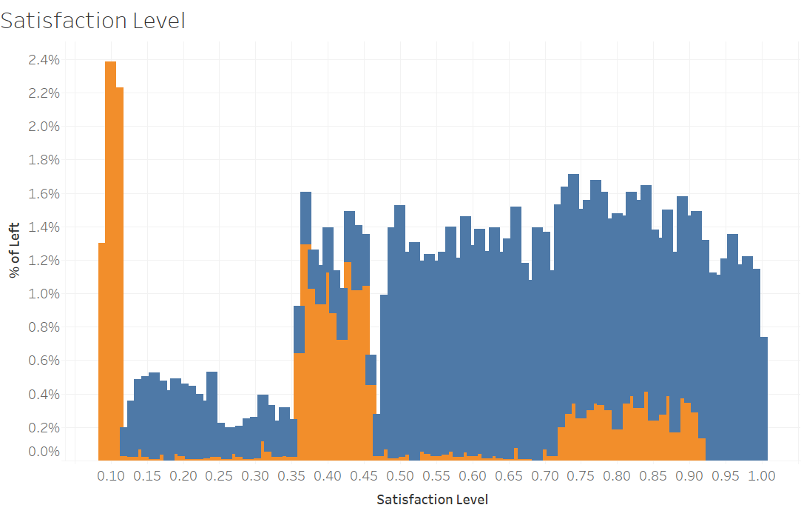
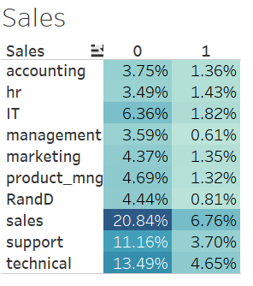
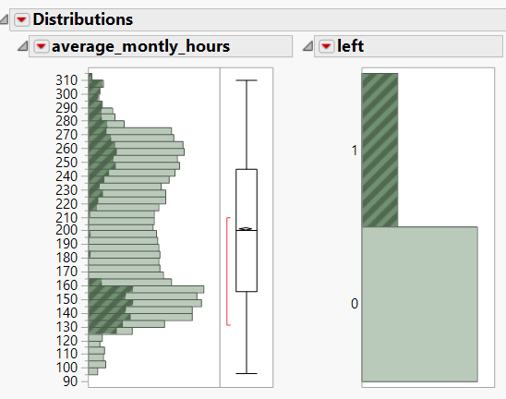
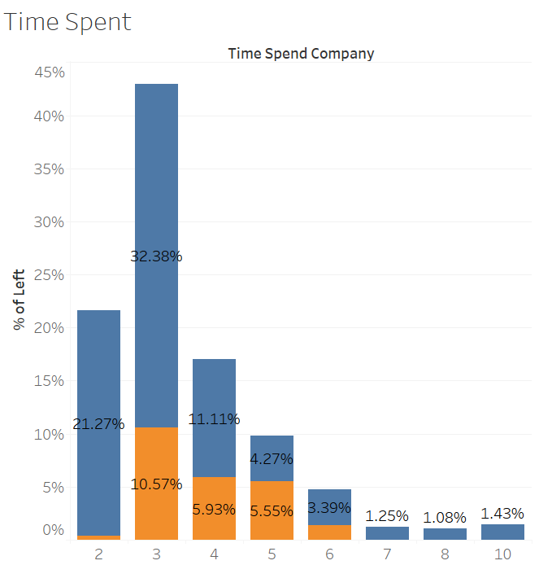
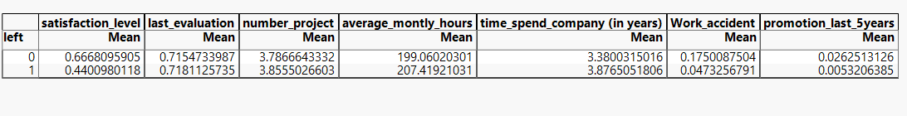
Bivariate analysis gives an indication about some possible characteristics of turnover
left vs. satisfaction_level
left vs. sales
left vs. average_monthly_hours
left vs. time_spend_company

Slide 9
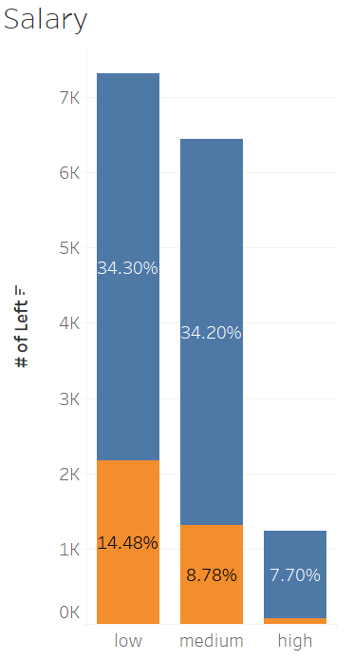
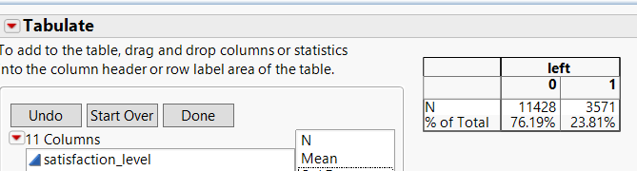
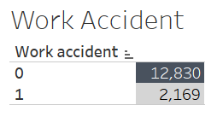
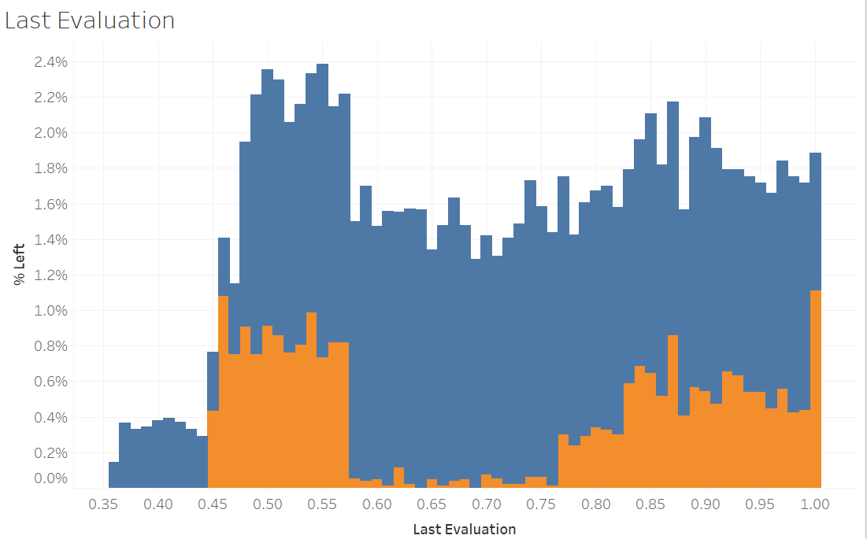
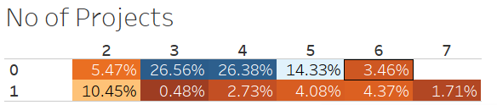
Bivariate analysis gives an indication about some possible characteristics of turnover
Employee Turnover Rate
left vs. satisfaction_level
left vs. number_project
left vs. last_evaluation
left vs. salary

Slide 10
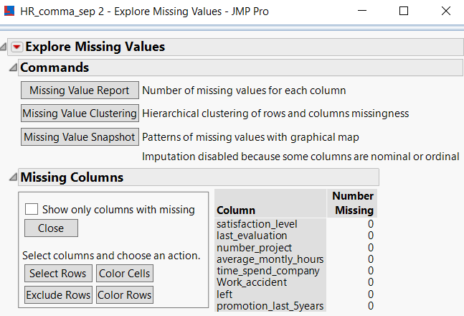

Examine the dataset to make sure there are no missing values

Slide 11
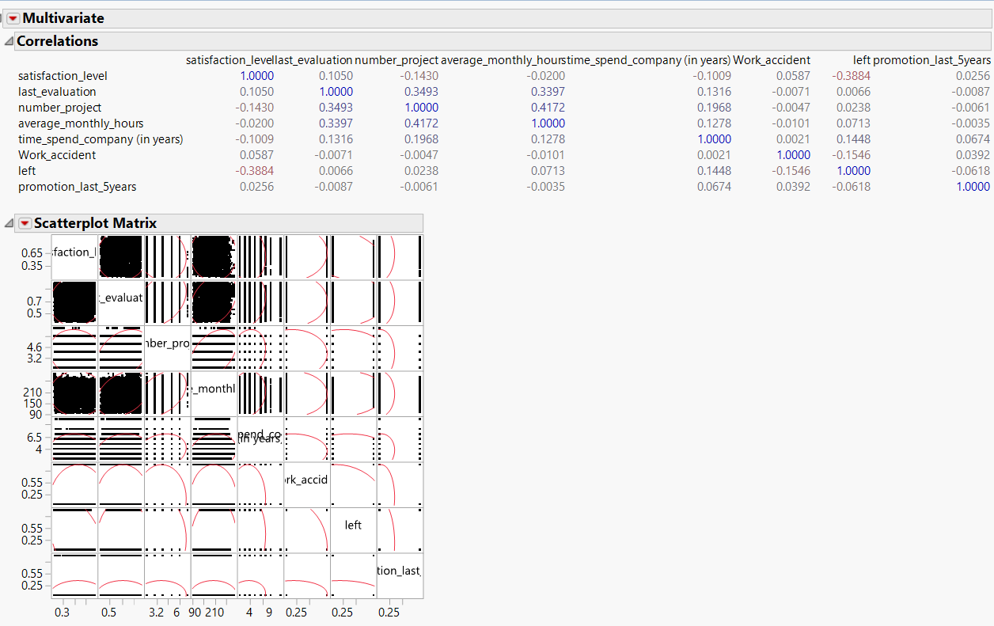
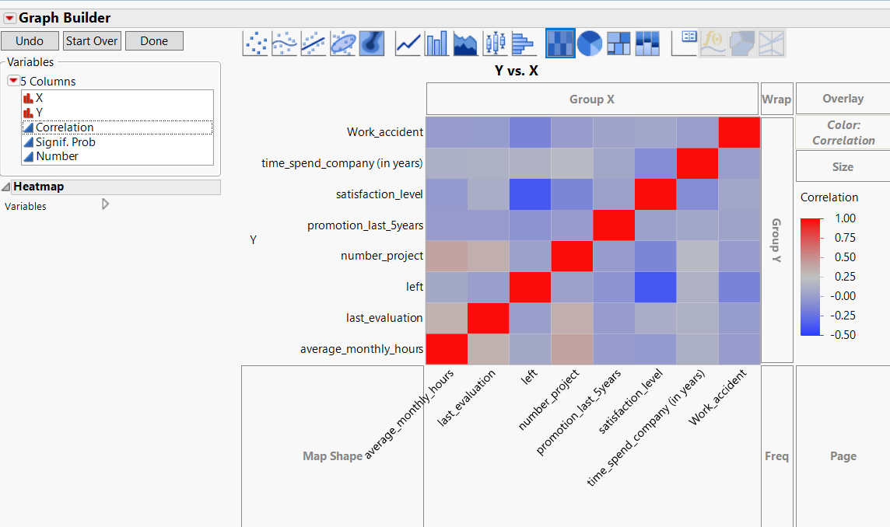
Examining the Correlation of the dataset for variable reduction

Slide 12
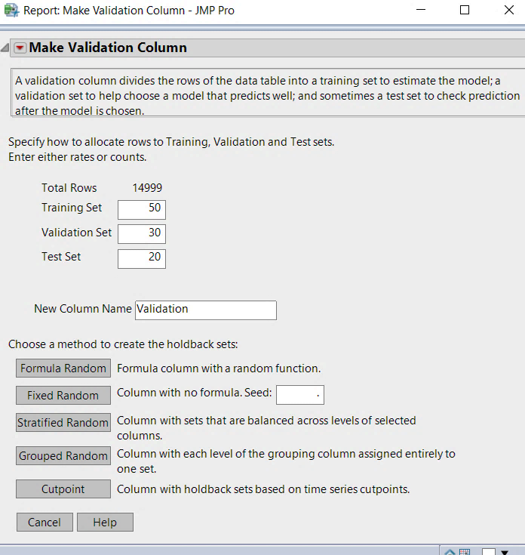
Partitioning the Data Set and Various Models used for Classification Problem
Nominal Logistic
Decision Tree (Partition)
Boosted Tree
Bootstrap Forest
Neural
Test
20 %
Validation 30 %
Training 50 %
Stratified based on Target Variable

Slide 13
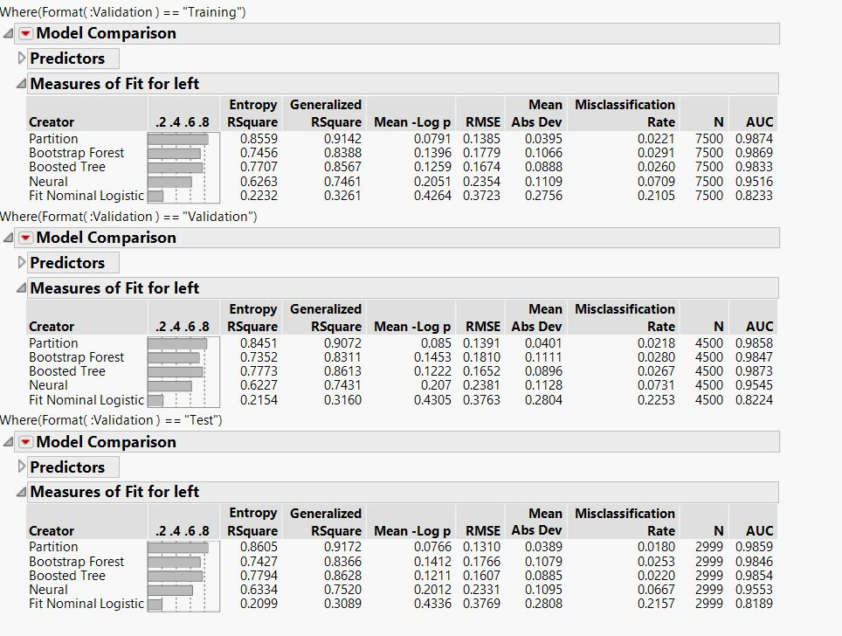
Choosing the best fit model on the basis of various parameters for Classification Problem
2%
3%
3%
7%
70%
22%
Logistic
Neural
Boosted
Partition
Bootstrap
Misclassification Rate

Slide 14
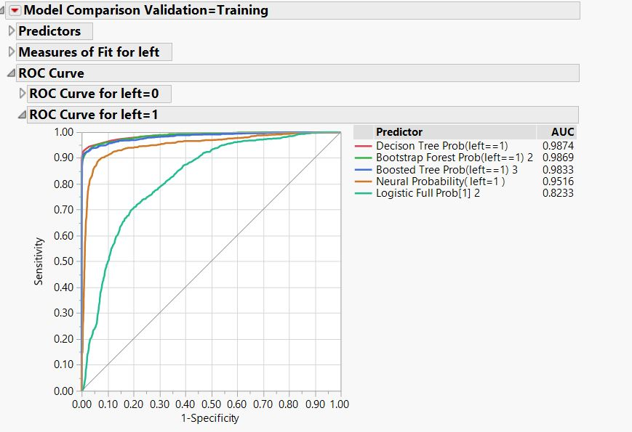
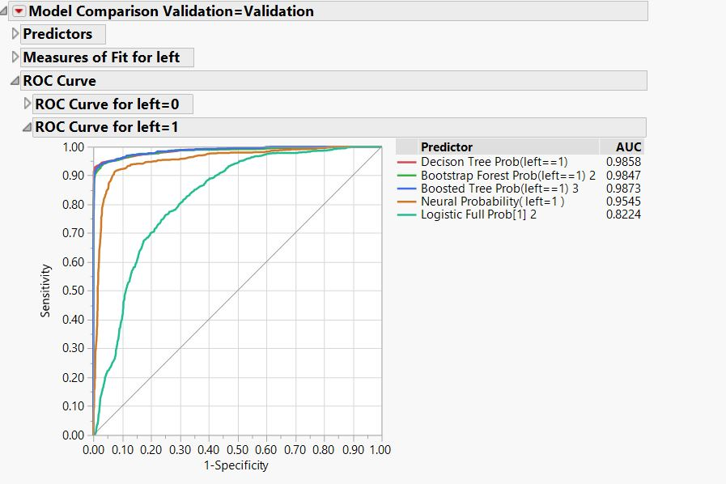
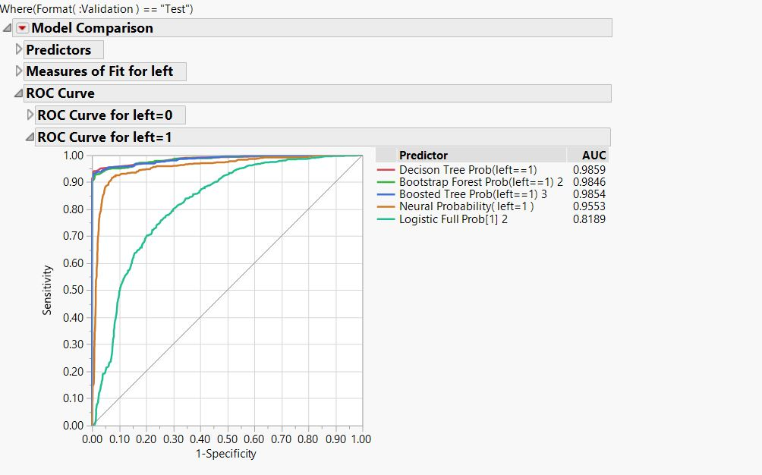


Further Evaluating the Performance with LIFT and ROC
Nominal Logistic
Decision Tree (Partition)
Boosted Tree
Bootstrap Forest
Neural

Slide 15
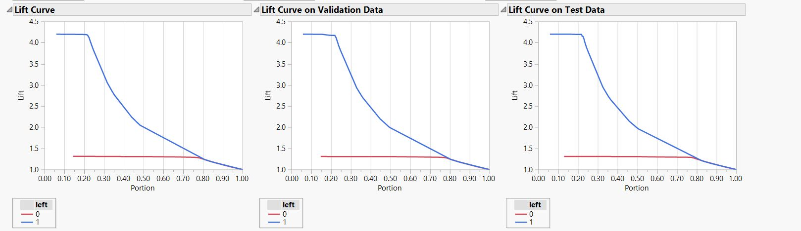


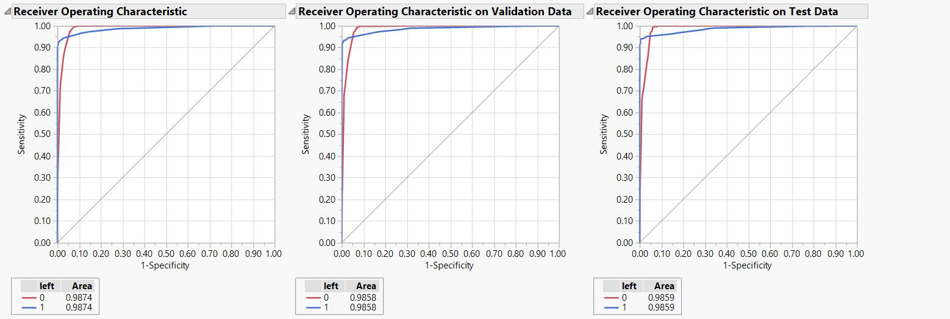

LIFT and ROC CURVE using Partition model
LIFT Curve
ROC Curve

Slide 16


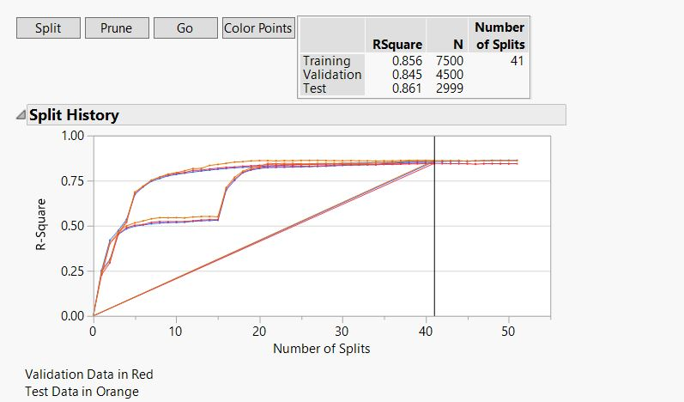
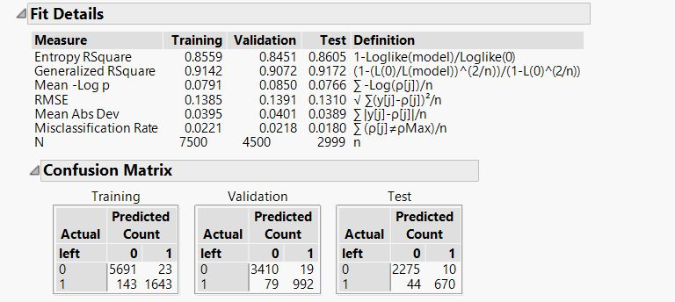

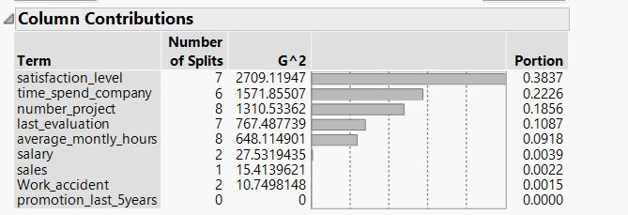


Next steps for better model accuracy statistics and having a detailed employee profile for prediction
Satisfaction Level
Time Spend Company
Number of Projects
Average Monthly Hours
Last Evaluation

Slide 17










24%
Medium and Lower Wage
10.45%
Work Allocation: 2 Projects.
Business Insights
44%
Low satisfaction level
Key factors driving the attrition rate
23.68%
No Promotion
22%
3-5 years of Work Experience

Slide 18








What steps can we take to retain employees?
01
02
03
04
EMPLOYEE ENGAGEMENT
GROWTH
RECOGNITION
ROOT CAUSE
HR team should make constant efforts to make employee engagement.
Rewards and Recognitions makes an employee feel valuable
Ample growth opportunities should be there(horizontal growth).
Perform an In-depth study about the other causes associated with it.

Slide 19
References
https://www.kaggle.com/ludobenistant/hr-analytics-1/data
https://dupress.deloitte.com/dup-us-en/focus/human-capital-trends/2015/people-and-hr-analytics-human-capital-trends-2015.html
http://data-informed.com/deliver-business-value-with-predictive-workforce-analytics/

Slide 20


